Slide 1
Trading as a game
PRESENTATION based on "FINANCIAL TRADING AS A GAME: A DEEP REINFORCEMENT LEARNING APPROACH" BY CHIEN YI HUANG
Michał Jan Matejczuk, Aleks Patryk Kapich, Jakub Piotr Lange

Slide 2
Agenda
Introduction – motivation, goals and challenges
2. Setting up the MDP
3. Model performance

Slide 3

Motivation
Source: https://www.deviantart.com/sadbutambitious/art/Stonks-803456089

Slide 4
Basic assumptions
The agent trades on Forex – an exchange for trading currencies
Every order is placed with all of the money available
We evaluate the solution on 12 different currency pairs

Slide 5
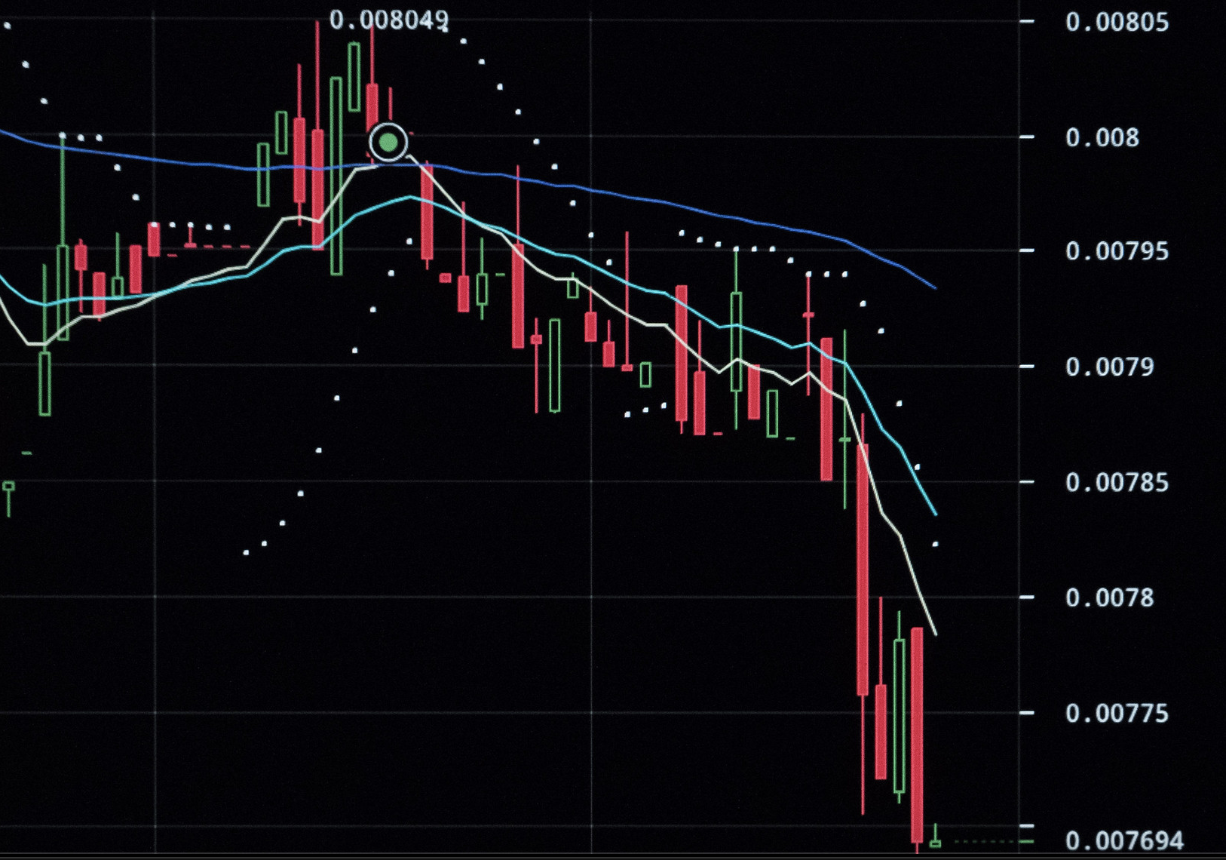
How is it done "normally"?
Source: https://www.flickr.com/photos/danielfoster/48630187173

Slide 6

challenges
Lack of baseline
Data quality / availability
Partially observability of financial markets
Exploration / exploitation dilemma (transaction costs)

Slide 7
STATE SPACE
The state constists of three main parts:
Time feature – vector of three values: minute, hour and day of week
Market feature – OHLCV + 8 most recent log returns on both closing price + tick volume (number of price changes)
Position feature – a set of three values: {-1, 0, 1}

Slide 8
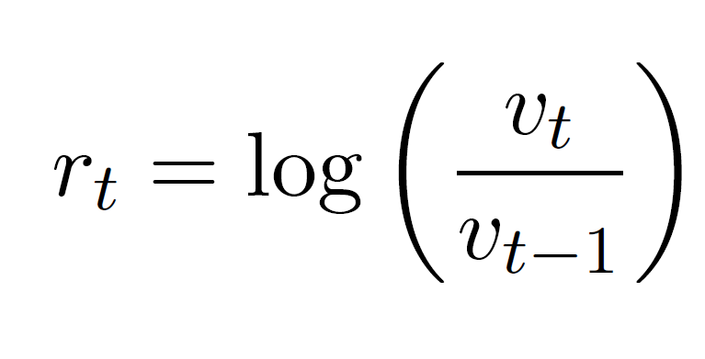
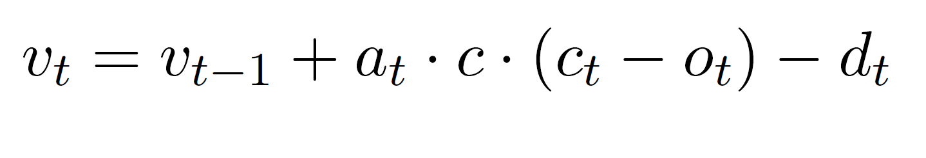
Reward function & portfolio value
Source: https://arxiv.org/abs/1807.02787

Slide 9
DEEP q-learning
Key difference: q-function is represented as neural network instead of transition table.
The neural network takes states as inputs and the output consists of q-values for each action.
Any updates are imposed through neural network training

Slide 10
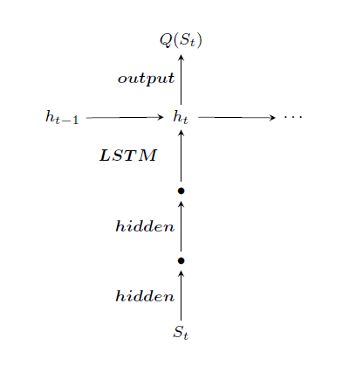
Training scheme
LSTM architecture brings advantage in the context where agent faces trading task
Source: https://arxiv.org/abs/1807.02787

Slide 11
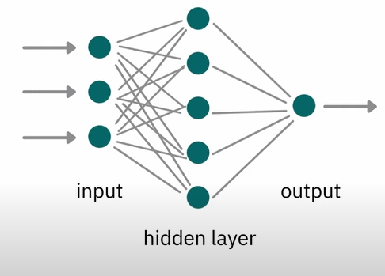
Classic neural networks
Source: https://www.youtube.com/watch?v=y9PLF2GsD-c&t=114s&ab_channel=M%C4%B1sraTurp

Slide 12
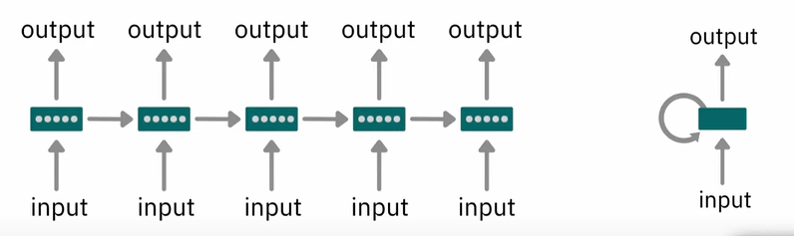
Recurrent neural networks
Source: https://www.youtube.com/watch?v=y9PLF2GsD-c&t=114s&ab_channel=M%C4%B1sraTurp

Slide 13
Action augmentation
Source: https://arxiv.org/abs/1807.02787

Slide 14
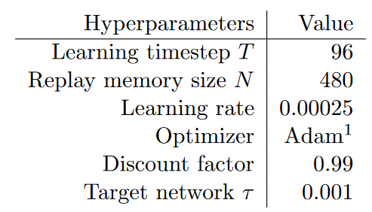
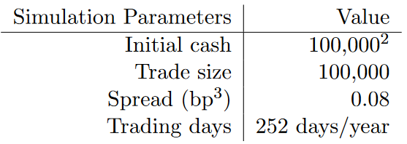
parameters

Slide 15
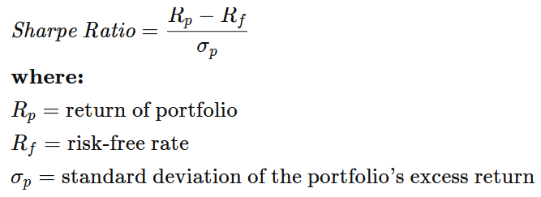
Performance metrics
https://www.investopedia.com/terms/s/sharperatio.asp

Slide 16
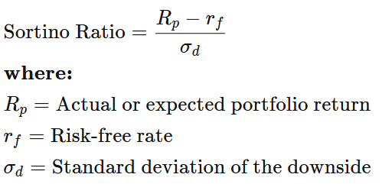
Performance metrics
https://www.investopedia.com/terms/s/sortinoratio.asp

Slide 17
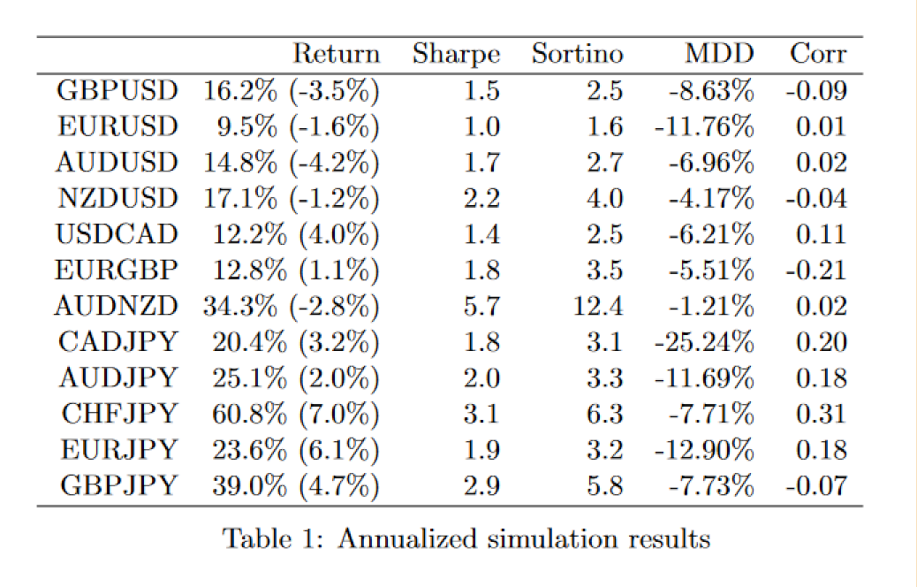
Model performance

Slide 18
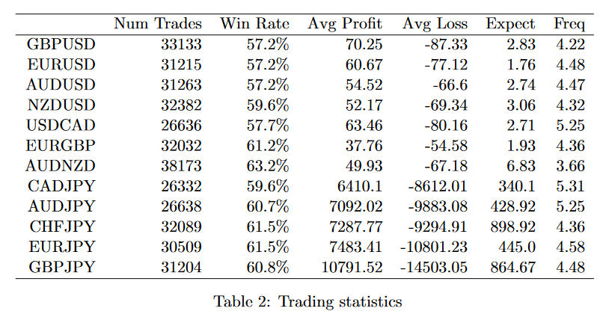
Model performance

Slide 19
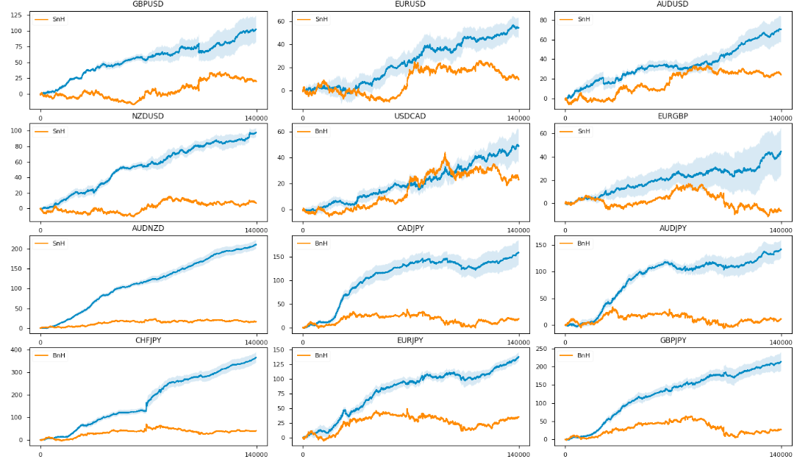
Model performance

Slide 20
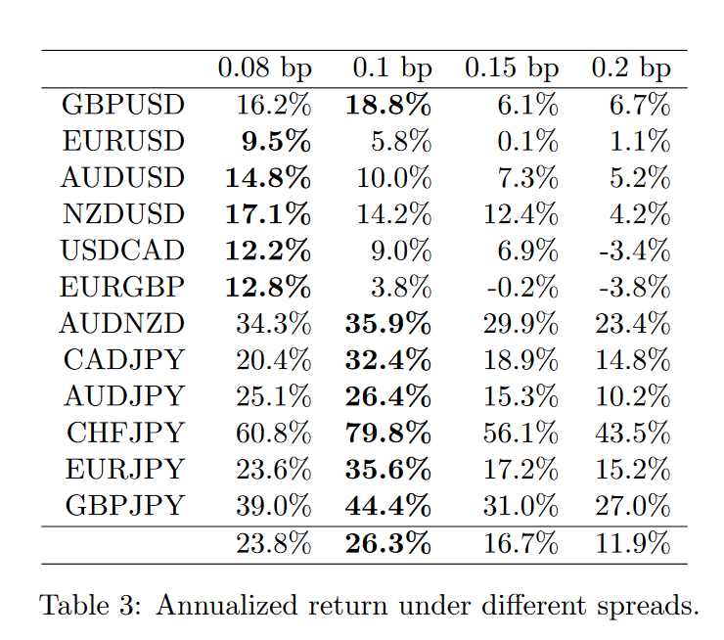
Experimenting with spread

Slide 21
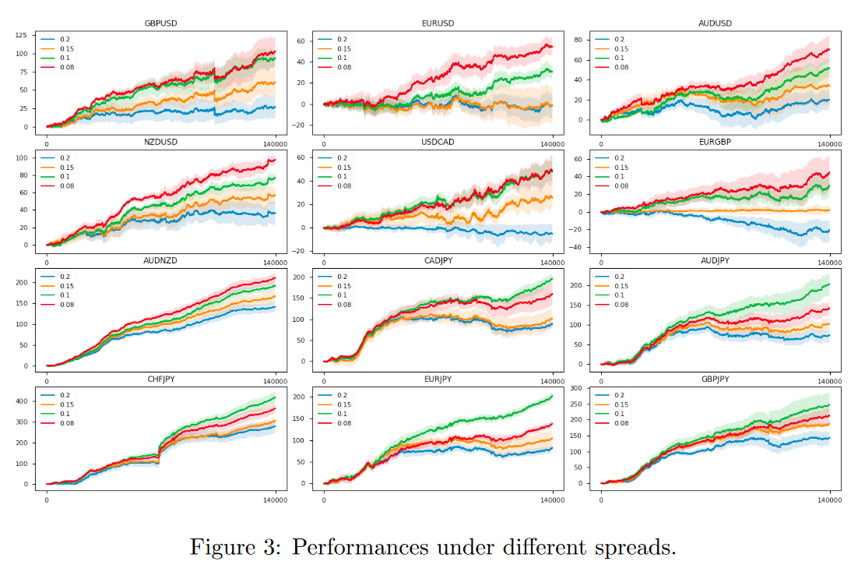
Experimenting with spread

Slide 22
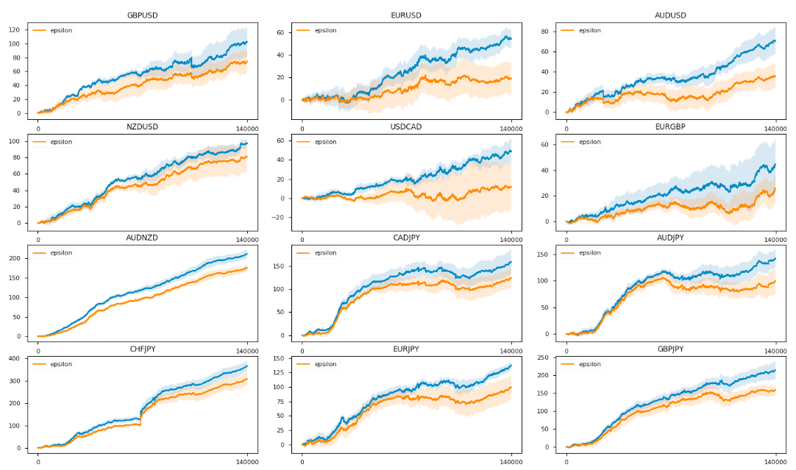
Action augmentation vs epsilon

